Slide 1
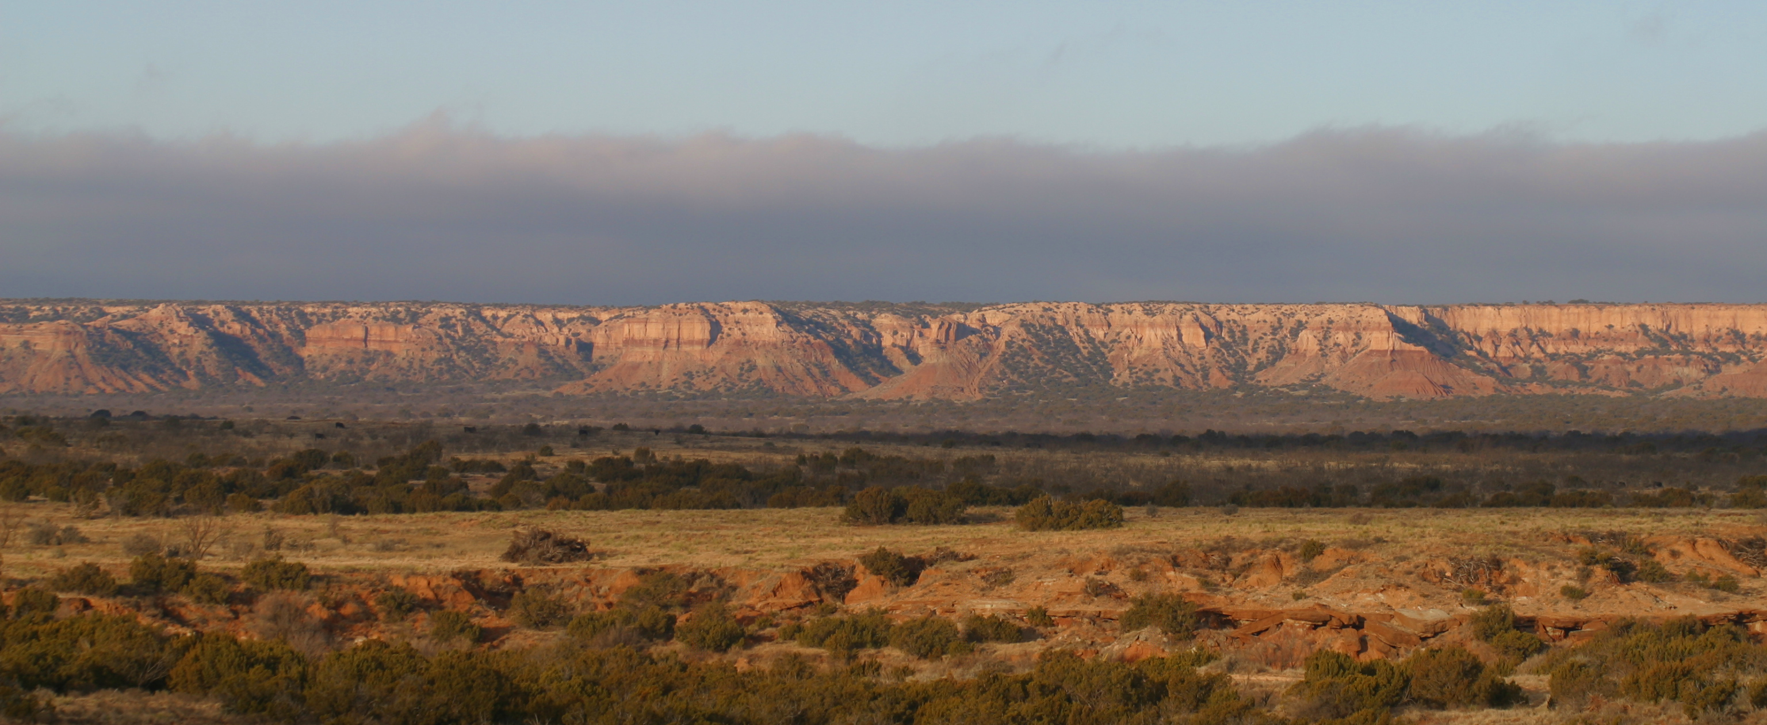
Dallas to Lubbock: A Deep Map
Presented to the West Texas Historical Association
Annual Conference, April 10th, 2026

Slide 2
Why “Dallas to Lubbock”? A very simple origin story
2015: Daughter enrolls at TTU
  I began travelling (speeding) between Dallas and Lubbock
2019: After her graduation…
  I slow down, wise up, look around, learn, tell and re-tell
Central Challenge
  Can I bring coherence to the otherwise unrelated people and places along 330 miles of Texas highways?²

Slide 3
What’s a “Deep Map”?¹
A “vertical” map; goes “deep”
Social/natural/oral history and ecology of a place as interconnected
Purposes:
  Connect and re-connect with a place
  Honor, protect and preserve a place
  Demonstrate that any place is ‘deep’
    …and interesting, meaningful, moral

Slide 4
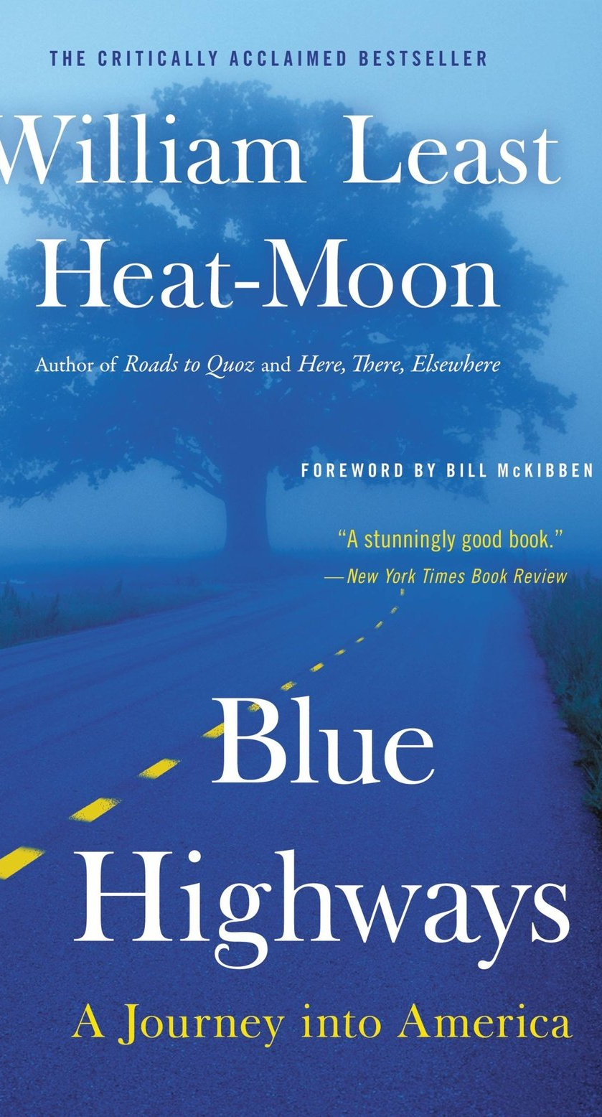
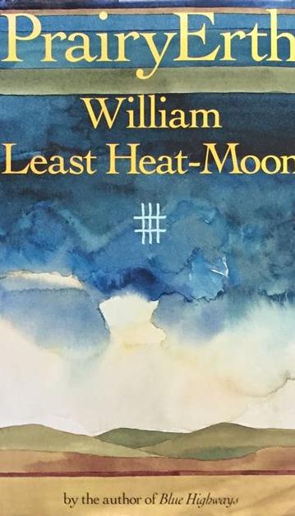
Inspiration and Precedent
William Least Heat-Moon (b. 1939)
  Author
  Originator of ‘deep map’ writing
  Blue Highways (1982); PrairyErth (1991)
John McPhee (b. 1931)
  Author
  Deep history of the American landscape
  Annals of the Former World (1998; Pulitzer Prize, 1999)
Studs Terkel (1912-2008)
  Author; oral historian
  Ordinary Americans, in their own voices
  Working (1974)

Slide 5
My version of a deep map
All the above, and…
Future(s) of places
Travel between places
Thus, for me a deep map is
  A collection of stories…
  Of the interconnected past, present and envisioned futures of people and places…
  And a guide for travelling between them
Deep Map
Envisioned Futures
Social, Oral History
Ecology
Natural History

Slide 6
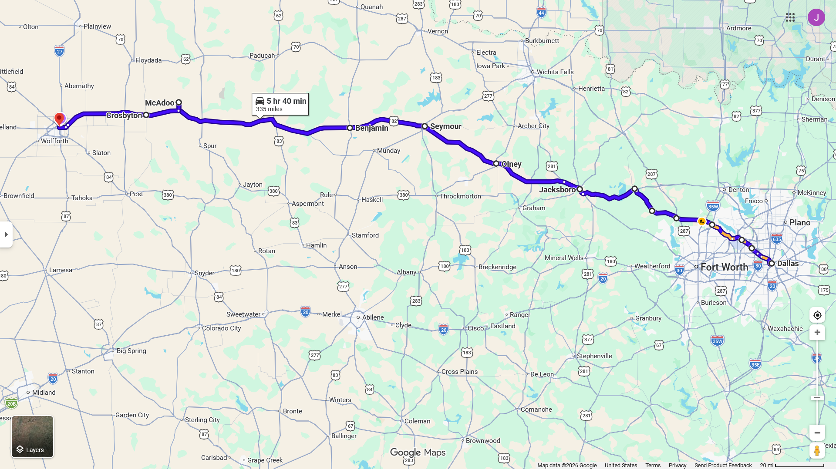
SH114 - It’s the only way to fly
Lubbock
Lubbock
100th
Google Maps; Logo: Matthew Anderson

Slide 7
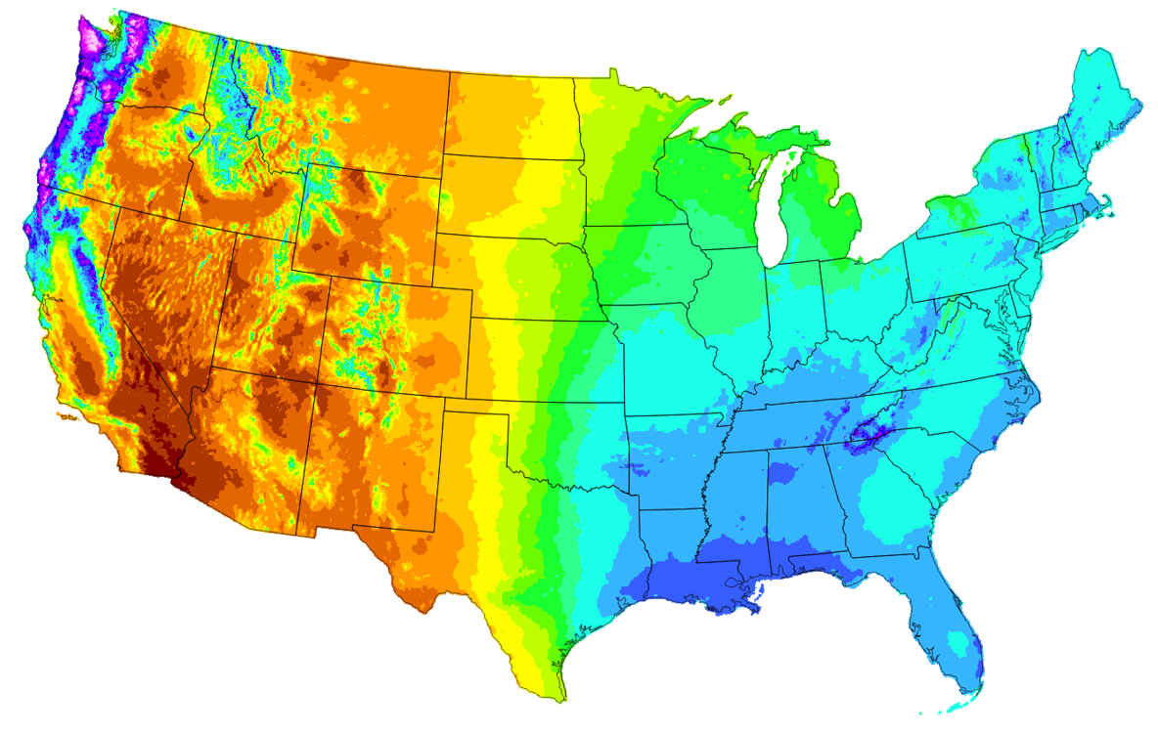
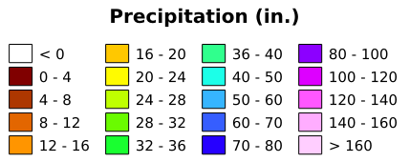
Crossing the 100th Meridian—this alone is sufficient for giving coherence to a journey from Dallas to Lubbock
L
D
100th Meridian, with Avg. Annual Precip. 1991-2020
Modified from source by PRISM Climate Group, Oregon State University

Slide 8
Travelling from Dallas to Lubbock you will:
Cross over the 100th meridian
  With Africa’s Sahel, the starkest line of demarcation—of aridity and population density—anywhere on the planet (Seager)
Go from ~39 inches of annual rainfall to half that
  From humid subtropical climate (Cfa) to semi-arid (BSk) (NOOA, 2023)
  Travel through 10 Level-4 Ecoregions (EPA)
Move from cramped to cozy³
  ~90 ft. from your nearest neighbor in Dallas
  ~1.2 miles apart in Guthrie
  ~120 ft. in Lubbock
Climb from 450 ft. to 3,200 ft.
Re-trace the paths of some of America’s last frontier settlers

Slide 9
Four topographical chapters of the journey
Dallas to Jacksboro—Crossing the Cross Timbers
Jacksboro to Seymour—Western Cross Timbers to the Rolling Plains
Seymour to Crosbyton—Climbing the Caprock
Crosbyton to Lubbock—High Plains Drifting

Slide 10
Today: Two stops along the way
Dallas to Jacksboro--Crossing the Cross Timbers
Jacksboro to Seymour—Western Cross Timbers to the Rolling Plains
Seymour to Crosbyton--Climbing the Caprock
Crosbyton to Lubbock--High Plains Drifting
Jacksboro
Bub Eldredge, McAdoo

Slide 11
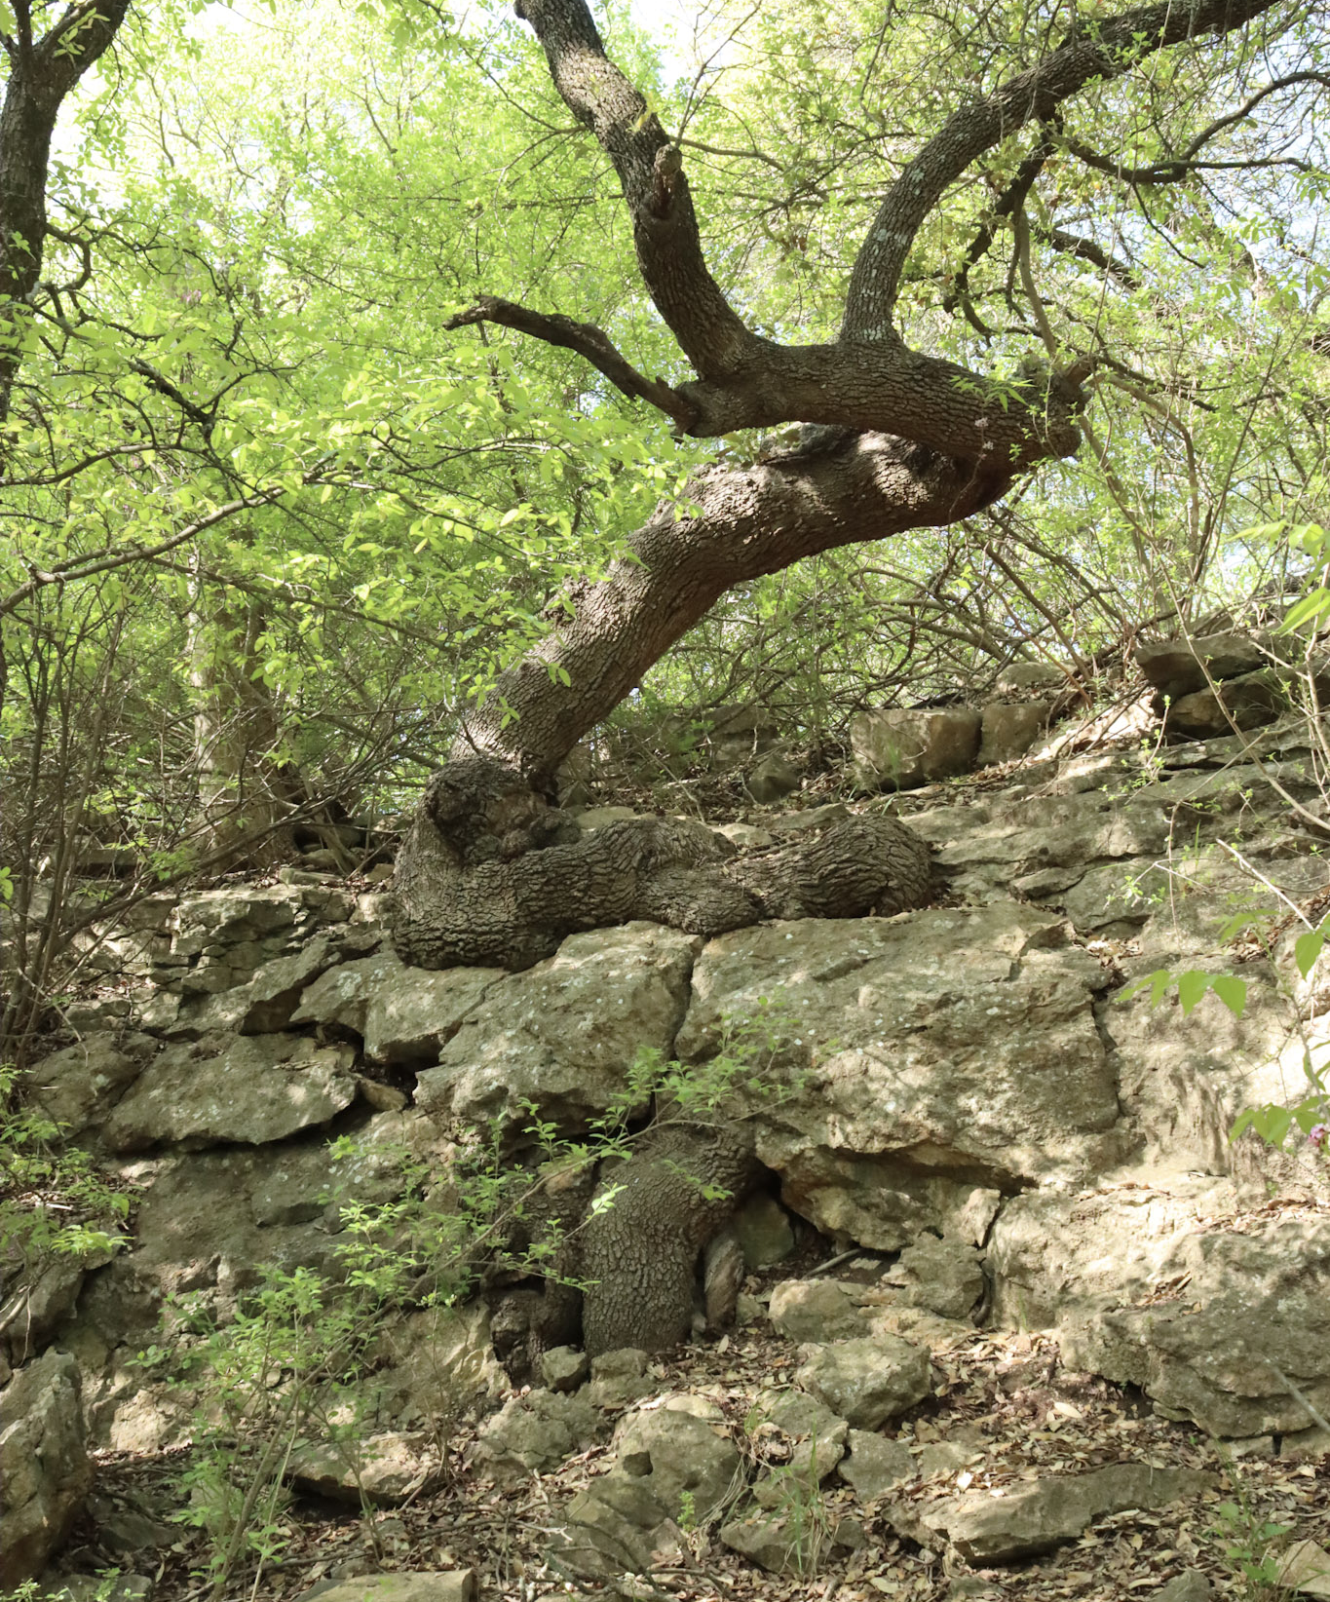
Jacksboro
It’s all about the rocks
(and the trees)

Slide 12
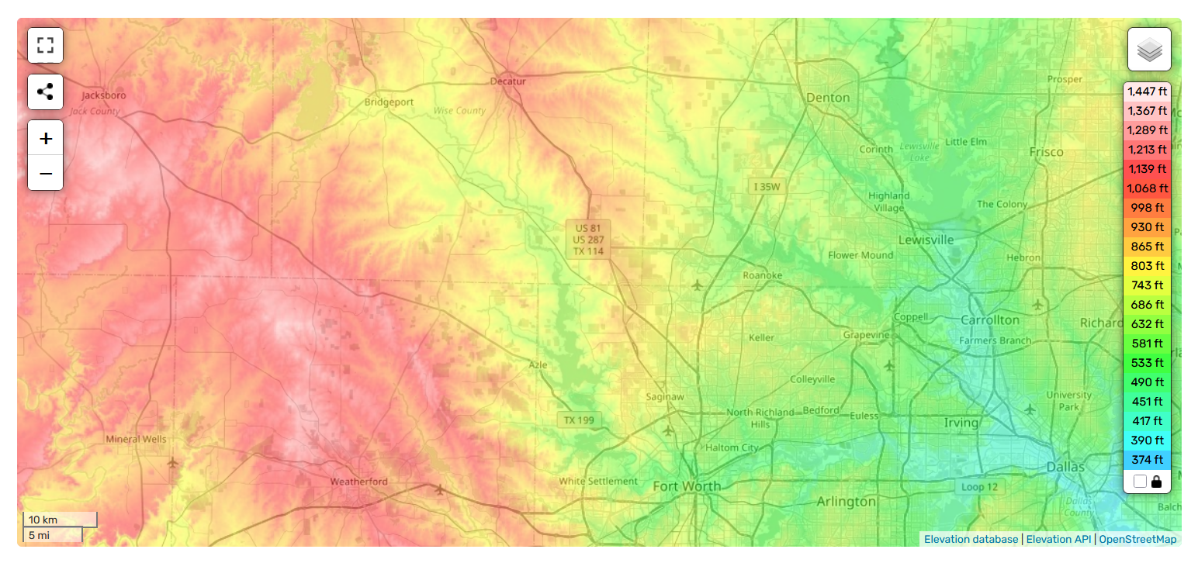

Travelling from the flatlands of Dallas, the ascent into Jacksboro is a modest but welcome change (~650ft.)
Jacksboro
J
D
Dallas
Source: Topographic-map.com

Slide 13
Sandstone/limestone formations create the ascent
Older, harder rocks under Jacksboro erode slower
  Pennsylvanian Period, 300 Ma (BEG, 2026)
Younger, softer rocks under Dallas erode faster
  Cretaceous Period, 90Ma (Fisher, 1987)
After ~40 million years of differential erosion Dallas sits ~650ft. lower than Jacksboro (BEG, 1972)

Slide 14
These same rocks, which lie just below the surface, largely determine the vegetation above⁴
Western Cross Timbers (WCT)⁵
  Ancient, slow-growth forests of Blackjack Oak and Post Oak
  Some Post Oaks 200-300 yrs. old, but only 30 ft. high
  Multiple trunks per tree, in close proximity
  Well-suited for thin soil and harsh conditions
Dense understory of tangled vines and briers
  Also well-suited for thin, acidic soils and partial shade
  Saw Greenbrier, Virginia Creeper, Mustang Grape, Poison Ivy
‘Cast Iron Forest’
  Tree trunks in close proximity + dense understory = nearly impassible

Slide 15
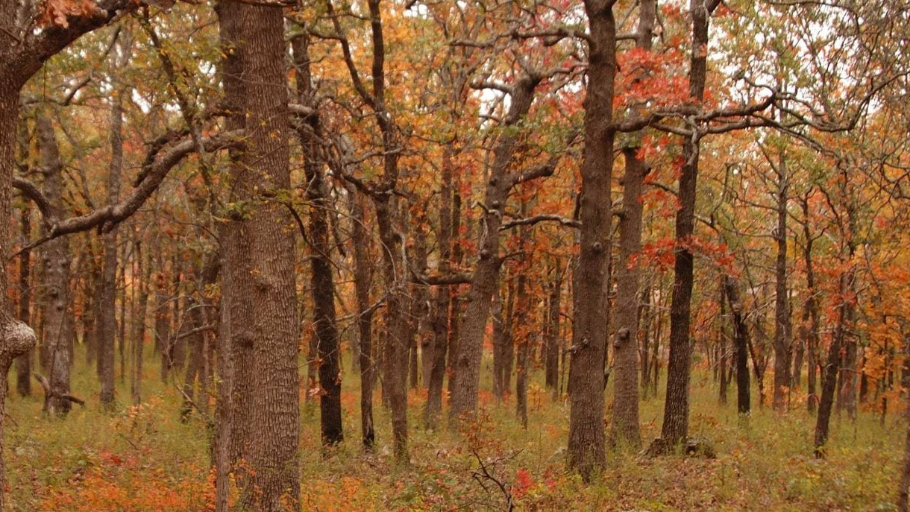

Slide 16
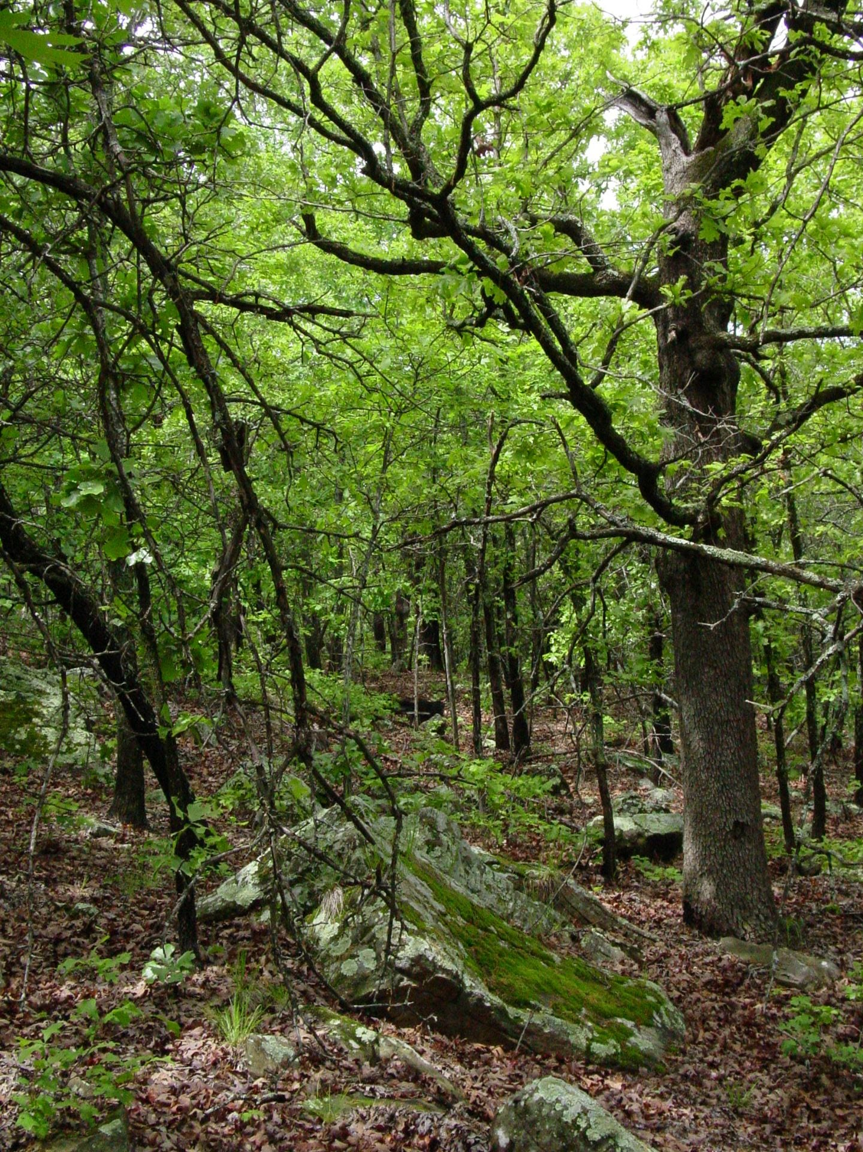

Slide 17
These same rocks, which are just below the surface, largely determine the vegetation above⁴
Western Cross Timbers (WCT)⁵
  Ancient, slow-growth forests of Blackjack Oak and Post Oak
  Some Post Oaks 200-300 yrs. old, but only 30 ft. high
  Multiple trunks per tree, in close proximity
  Well-suited for thin soil and harsh conditions
Dense understory of tangled vines and briers
  Also well-suited for thin, acidic soils and partial shade
  Saw Greenbrier, Virginia Creeper, Mustang Grape, Poison Ivy
‘Cast Iron Forest’
  Tree trunks in close proximity + dense understory = nearly impassible
  “It was like struggling through forests of cast iron.” Washington Irving, A Tour on the Prairies, 1835 (p. 113)

Slide 18
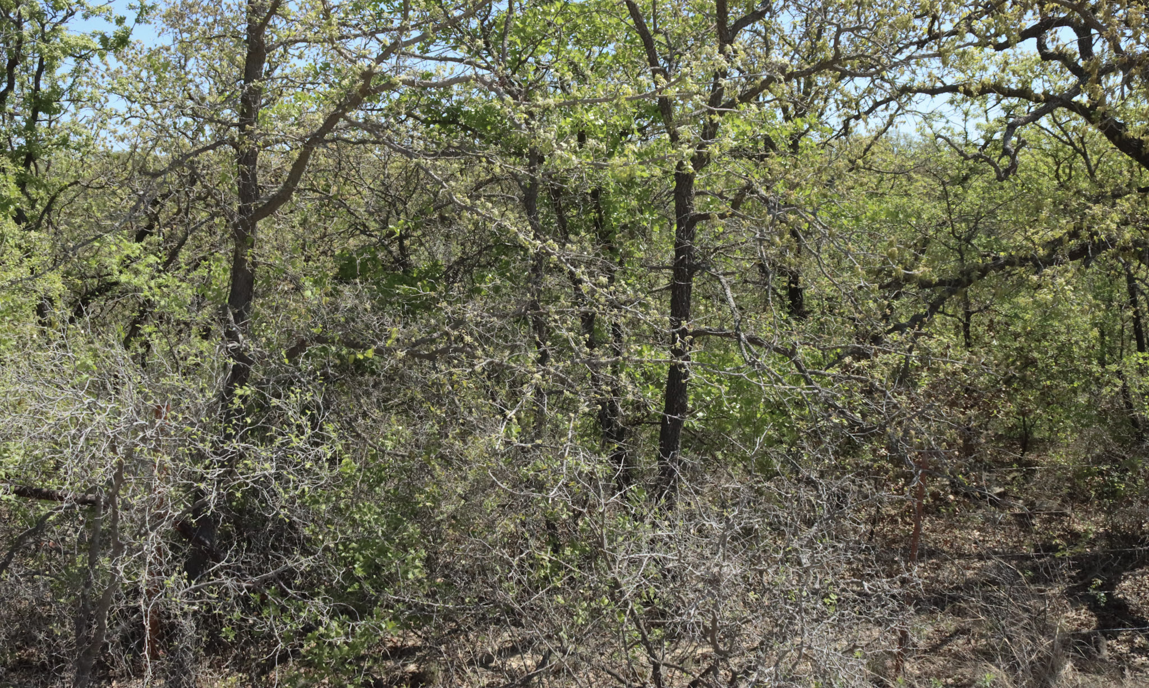
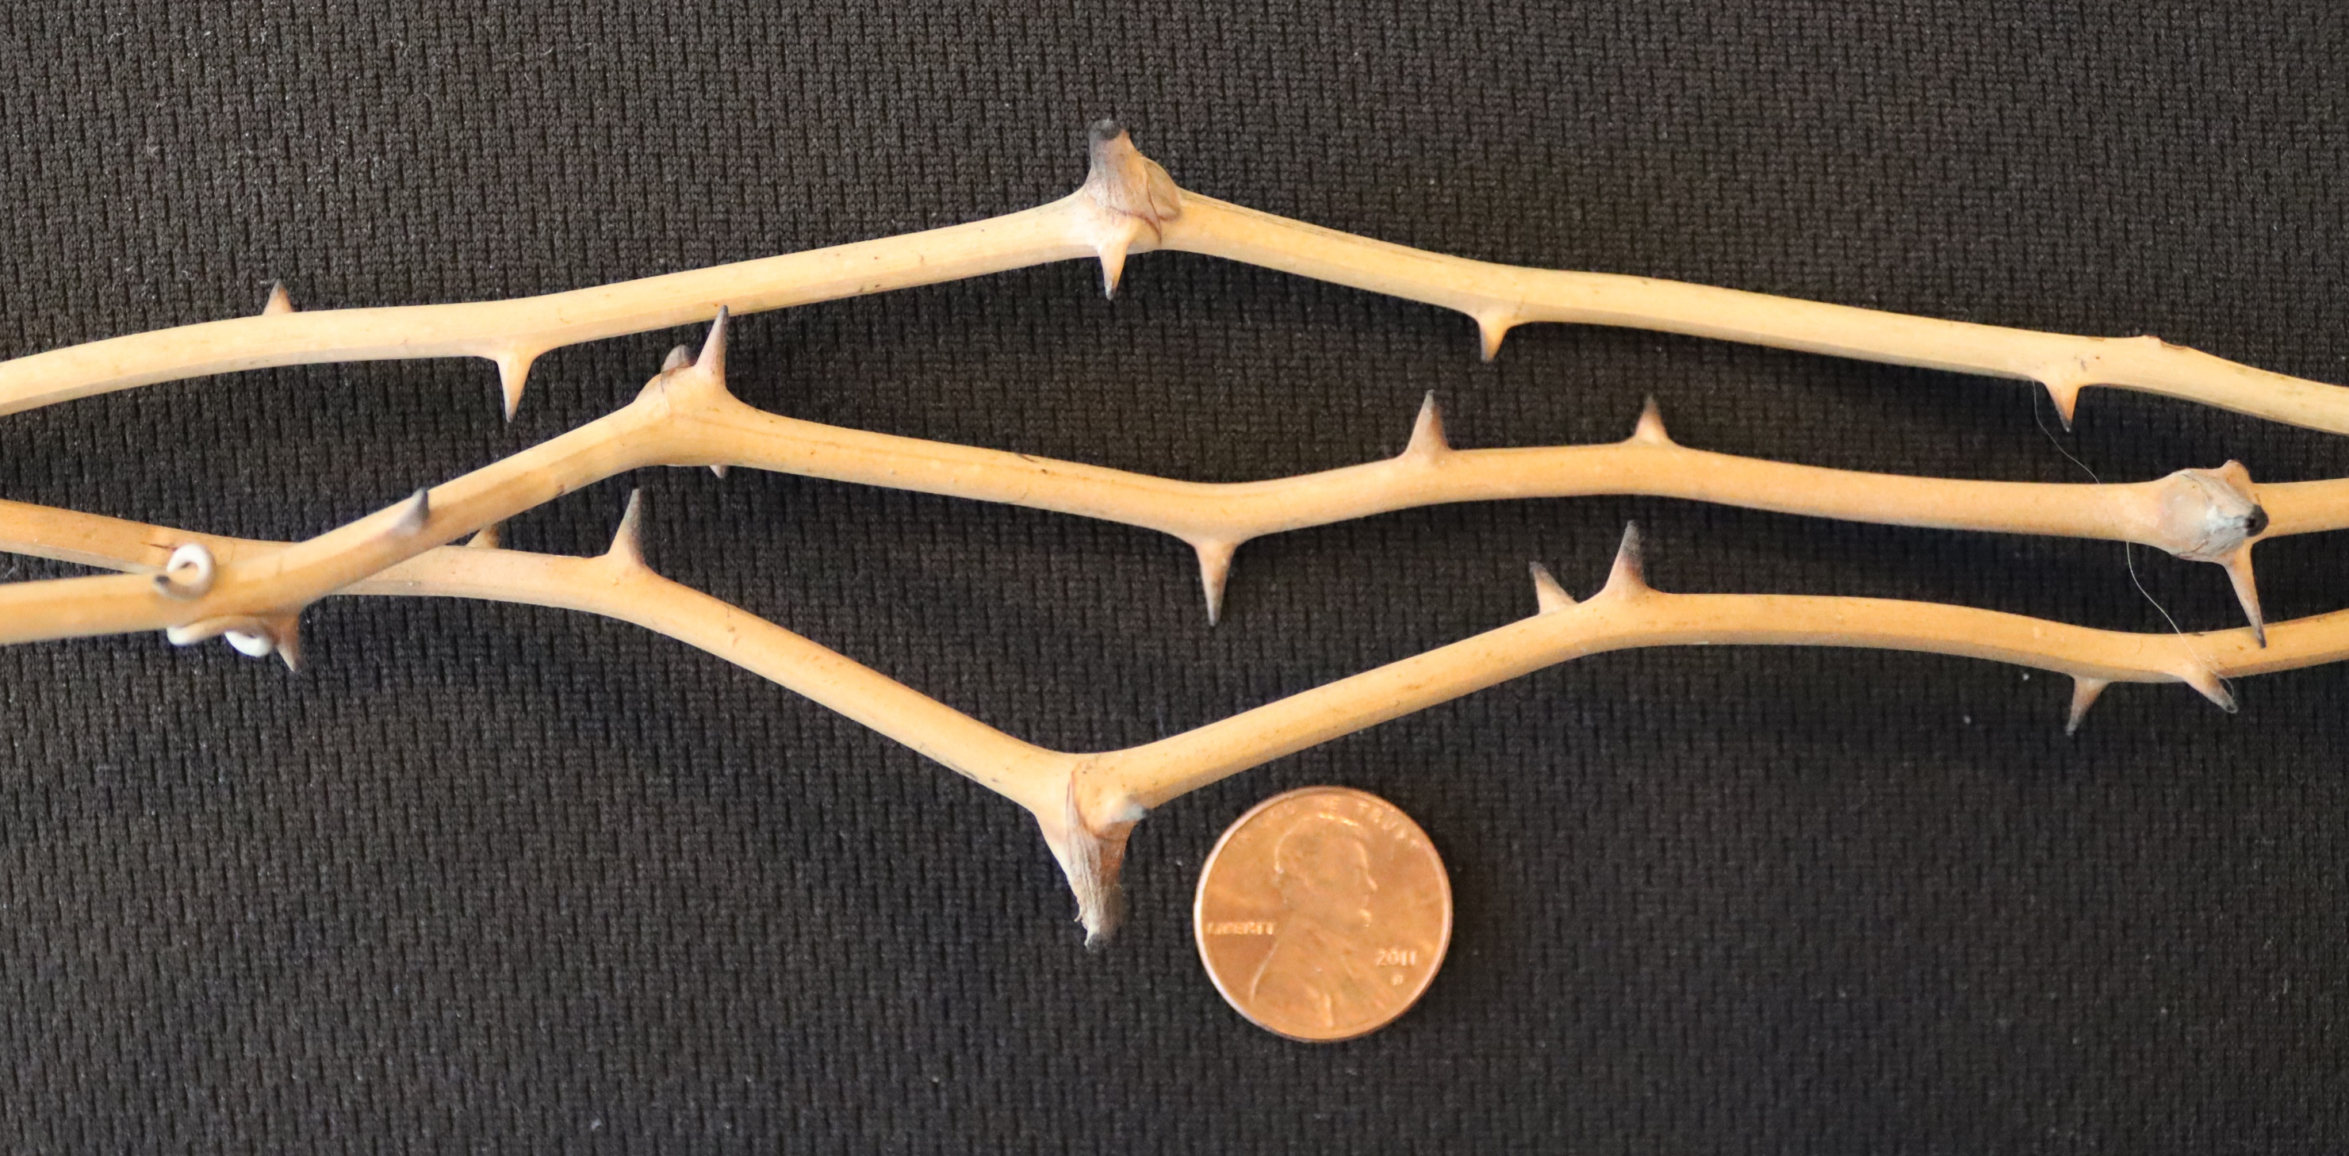

Slide 19
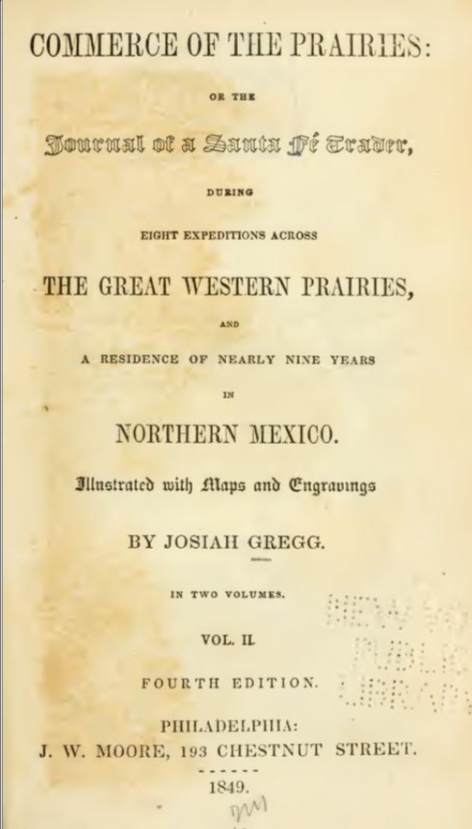
Josiah Gregg, Commerce of the Prairies, 1849, Vol. II, p. 199
“The underwood is so matted in many places with grape-vines, green-briars, etc., as to form almost impenetrable ‘roughs,’ which serve as hiding-places for wild beasts, as well as wild Indians; and would, in savage warfare, prove almost as formidable as the hammock of Florida”⁶

Slide 20
Western Cross Timbers—Important role (actor?) in the history of Jacksboro and the region
Oldest Post Oaks (300+ yrs) witnessed arrival of first Spanish explorers in 1716 (Francaviglia, 2000, p. 28)
Major barrier to progress of settlers
Cover for Indian raiding parties (Robinson, 2016)
  Warren Wagon Train Massacre in 1871
  First trial of a Native American Indian in a US Court
But also, refuge for those same besieged settlers
  Including survivors of the Warren Massacre, who alerted General Sherman in Fort Richardson, Jacksboro, leading to arrest and trial

Slide 21


Slide 22
Buried Treasure
Sandstone/limestone are “reservoir rock”
Porosity and permeability make them a reservoir for oil and gas trapped thousands of feet below the surface
Oils & Gas: A mainstay of the Jacksboro economy

Slide 23
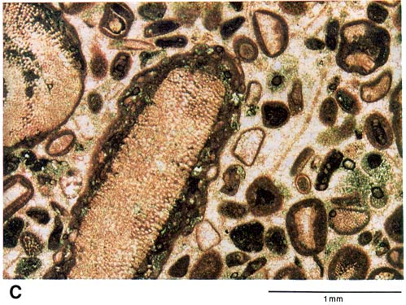
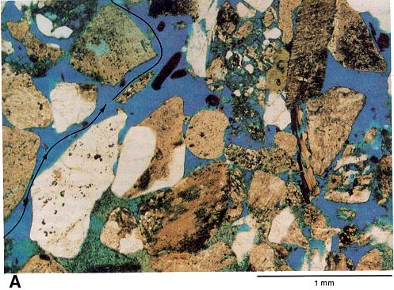
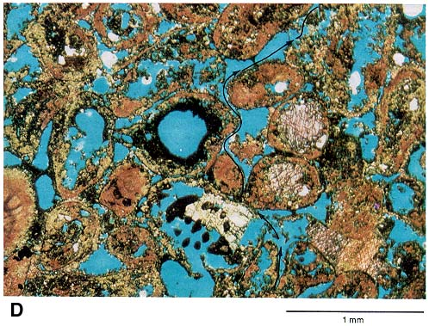
The best reservoir rocks are: 1) porous (storage capacity; space within) and 2) permeable (flow capacity; space between)
Photomicrographs of sedimentary rocks
Limestone
Sandstone (black arrow= flow)
Limestone (black arrow = flow)
Porous
Porous
Porous
Permeable
Permeable
Permeable
Source: Kansas Geological Survey

Slide 24
Bub Eldredge
McAdoo, Texas

Slide 25
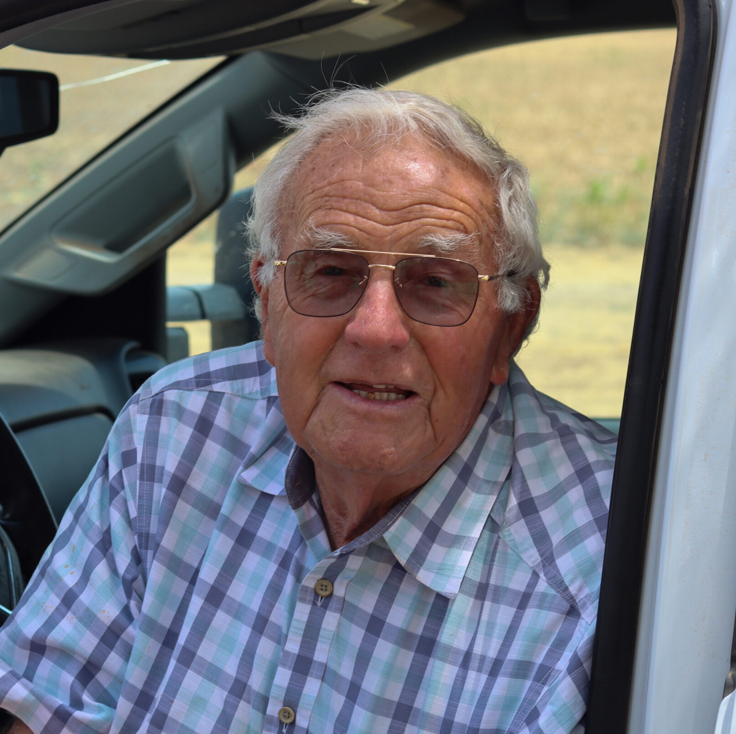
Born in 1938, Bub carries with him almost 80% of the history of McAdoo, founded in 1915
Principal, McAdoo H.S. (‘66 to ‘85)
Asst. Coach at McAdoo for three state championship teams (‘60, ‘63, ‘64)
Today: Bub manages 1,000 acres of crops and cattle
Bub Eldredge, McAdoo, TX

Slide 26
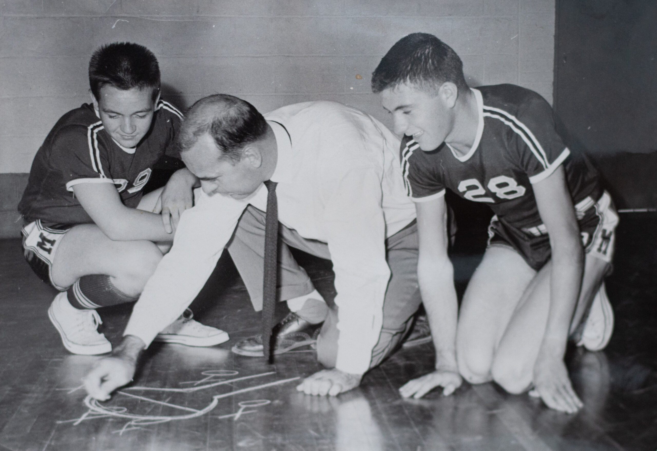

All this within Bub’s lifetime:
  1938: Battery power (wind- powered charger)
  1951: Electricity arrives (Dickens Electric Cooperative)
  2008: McAdoo Wind Farm begins operation
  2022: Argo begins bitcoin mining in Dickens, TX, near Bub’s acreage
  2024: Galaxy-Helios begins re- purposing Dickens facility to AI data processing center
Bub (r) with Coach Fabian “Doc” Lemley, 1955

Slide 27
Can I bring coherence to the otherwise unrelated people and places along 330 miles of Texas highways?
After a few years of work, the dots are beginning to connect!
I’d be honored to hear your story!
Thank you!

Slide 28
Dallas to Lubbock: A Deep Map
Presented to the West Texas Historical Association
Annual Conference, April 10th, 2026

Slide 29
References
American Forests. “The Cross Timbers: The Ancient Forest at America’s Crossroads.” American Forests, February 2, 2017. https://www.americanforests.org/article/the-cross-timbers-the-ancient-forest-at-americas-crossroads/.
Bodenhamer, David J., John Corrigan, and Trevor M. Harris, eds. Deep Maps and Spatial Narratives. Bloomington: Indiana University Press, 2015.
Bureau of Economic Geology, University of Texas at Austin, Geologic Atlas of Texas, Abilene Sheet, Virgil E. Barnes, project director (Frederick Byron Plummer Memorial Edition, 1972)
Bureau of Economic Geology. "Mineral Wells and Palo Pinto Country." Texas Through Time. University of Texas at Austin. https://www.beg.utexas.edu/texas-through-time/palo-pinto.html
Cohen, K.M., S.C. Finney, P.L. Gibbard, and J.-X. Fan. "The ICS International Chronostratigraphic Chart." Episodes 36 (2013): 199–204. Updated December 2024. https://stratigraphy.org/ICSchart/ChronostratChart2024-12.pdf
EPA Ecoregions of Texas: https://dmap-prod-oms-edc.s3.us-east-1.amazonaws.com/ORD/Ecoregions/tx/tx_eco_lg.pdf
Fisher, W. L., director. Geologic Atlas of Texas, Dallas Sheet. Revised edition. Austin: Bureau of Economic Geology, University of Texas at Austin, 1987.
Francaviglia, Richard V. The Cast Iron Forest: A Natural and Cultural History of the North American Cross Timbers. Austin: University of Texas Press, 2000.

Slide 30
References
Geertz, Clifford. The Interpretation of Cultures. New York: Basic Books, 1973.
Gregg, Josiah. Commerce of the Prairies; or, The Journal of a Santa Fé Trader. 2 vols. Philadelphia: J.W. Moore, 1849.
Heat-Moon, William Least. Blue Highways: A Journey into America. Boston: Little, Brown, 1982.
Heat-Moon, William Least. PrairyErth: A Deep Map. Boston: Houghton Mifflin, 1991.
Irving, Washington. A Tour on the Prairies. Paris: A. and W. Galignani and Company, 1835.
Kansas Geological Survey. “Geology of Petroleum.” Petroleum: A Primer for Kansas. Placed online April 2001. https://www.kgs.ku.edu/Publications/Oil/primer03.html
Mahon, John K. History of the Second Seminole War, 1835–1842. Revised ed. Gainesville: University of Florida Press, 1985.
McPhee, John. Annals of the Former World. New York: Farrar, Straus and Giroux, 1998.
National Oceanic and Atmospheric Administration. "JetStream Max: Addition Köppen-Geiger Climate Subdivisions." Last modified April 14, 2023. https://www.noaa.gov/jetstream/global/climate-zones/jetstream-max-addition-k-ppen-geiger-climate-subdivisions
PRISM Climate Group, Oregon State University. "Annual Climate Normals: Precipitation, 1991–2020." PRISM Climate Data. https://prism.oregonstate.edu.

Slide 31
References
Ricœur, Paul. Time and Narrative. 3 vols. Translated by Kathleen McLaughlin and David Pellauer. Chicago: University of Chicago Press, 1984–1988.
Robinson, Charles M., III. The Indian Trial: The Complete Story of the Warren Wagon Train Massacre and the Fall of the Kiowa Nation. Norman: University of Oklahoma Press, 2016.
Seager, Richard. "Whither the 100th Meridian? The Once and Future Physical and Human Geography of America’s Arid-Humid Divide." YouTube video, 30:32. South Central Climate Adaptation Science Center, October 15, 2019. https://www.youtube.com/watch?v=peP4K_WT5bc
Stegner, Wallace. Wolf Willow: A History, a Story, and a Memory of the Last Plains Frontier. New York: Viking, 1962.
Terkel, Studs. Working: People Talk About What They Do All Day and How They Feel About What They Do. New York: Pantheon Books, 1974.
Therrell, Matthew D., and David W. Stahle. 1998. “A Predictive Model to Locate Ancient Forests in the Cross Timbers of Osage County, Oklahoma.” Journal of Biogeography 25, no. 5: 847–854.
Topographic-Map.com. “Jacksboro, Texas, United States.” Accessed April 5, 2026. https://en-us.topographic-map.com/map-48b4tp/Jacksboro/?zoom=10&center=32.99553%2C-97.45758.
University Interscholastic League. “Boys Basketball State Champions.” Historical Archives, University Interscholastic League. Accessed April 5, 2026. https://www.uiltexas.org/historical-archives/athletics/archives/basketball/boys_champions.html
U.S. Census Bureau, QuickFacts, https://www.census.gov/quickfacts

Slide 32
Notes
This corresponds generally to the definition of ‘deep map’ according to author William Least Heat-Moon, who coined the term in PrairyErth (1991), but the practice has a longer lineage. Wallace Stegner's Wolf Willow (1962) and McPhee's geological narratives are regularly cited as precursors, and Bodenhamer, Corrigan, and Harris, in Deep Maps and Spatial Narratives (2015), called deep mapping "the essential next step" for humanities scholarship. The concept has also been traced to Clifford Geertz's "thick description" in The Interpretation of Cultures (1973) — the idea that understanding a place requires layering context upon context until meaning emerges from the accumulation.
Paul Ricœur, the French philosopher and historian, calls this process ‘configuration.’ It’s the act of taking all the scattered pieces of a journey — the changing land, the shifts in climate, the layered history — and shaping them into a coherent story that has a beginning, middle, and end. You’re actively giving form and meaning to raw experience. At the same time, there’s a caution: if you push the shaping too far, the story can slip into pure fiction and lose its grounding in the actual place and its history. (see References)
Calculated from US Census data (see U.S. Census in References)

Slide 33
Notes
In soil science, when soils are thin, the underlying rock — called the parent material — exerts a particularly strong influence on what vegetation can grow. Around Jacksboro, the Pennsylvanian sandstone creates thin, slightly acidic, nutrient-poor soils that drain rapidly and offer limited rooting depth. As Francaviglia notes (2000, p. 18), the correlation between Cross Timbers vegetation and this sandstone was so strong that late-nineteenth-century geologists began using the term “Cross Timbers” for the sandstone formation itself, whether or not the actual forest was present. Because of these harsh soil conditions, only the toughest species — primarily post oak, blackjack oak, elm and hardy vines such as saw greenbrier — are able to thrive here.
In the Western Cross Timbers of Texas, post oaks commonly reach 200–300 years of age, while trees over 400 years old are more frequently documented in Oklahoma. Remarkably, these ancient trees often stand only 15 to 30 feet tall. According to the Ancient Cross Timbers Consortium and the University of Arkansas Tree-Ring Laboratory led by David Stahle, even a 200-year-old post oak may be only about 30 feet in height (American Forests 2017; see also Therrell and Stahle, 1998).
The 'hammock' Gregg refers to is a dense stand of hardwood trees found within Florida's wetlands. During the Seminole Wars (1817–1858), Seminole warriors used these as natural, hidden fortresses, and a place from which to launch ambush attacks, and to mount their defense against U.S. Army forces (Mahon, 1985)

Slide 34
Photo Credits (unless cited on page, by page number)
Caprock Escarpment, seen from Farm to Market Road 669, Garza County, Texas. Author: Leaflet. Public Domain.
11 Author
15-16 Cross Timbers. Photo courtesy of Dr. David Stahle, University of Arkansas Tree-Ring Laboratory. Used by permission.
18, 21, 25 Author
26 Photographer unknown, 1955
Contact:
Jeff.Hicks@DallastoLubbock.com
Jeff.Hicks@UTDallas.edu
www.DallastoLubbock.com

